Slide 1
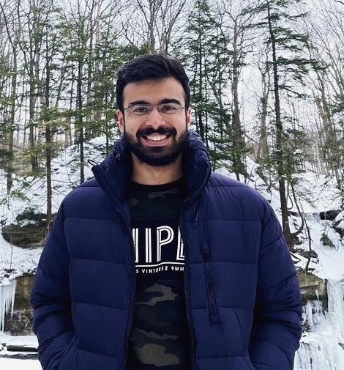
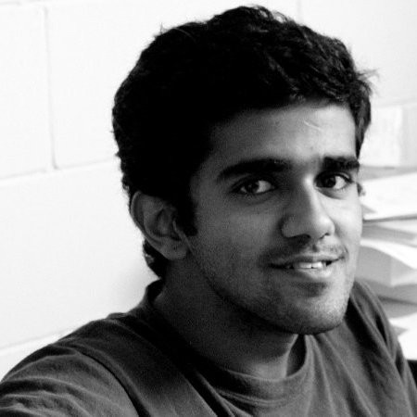
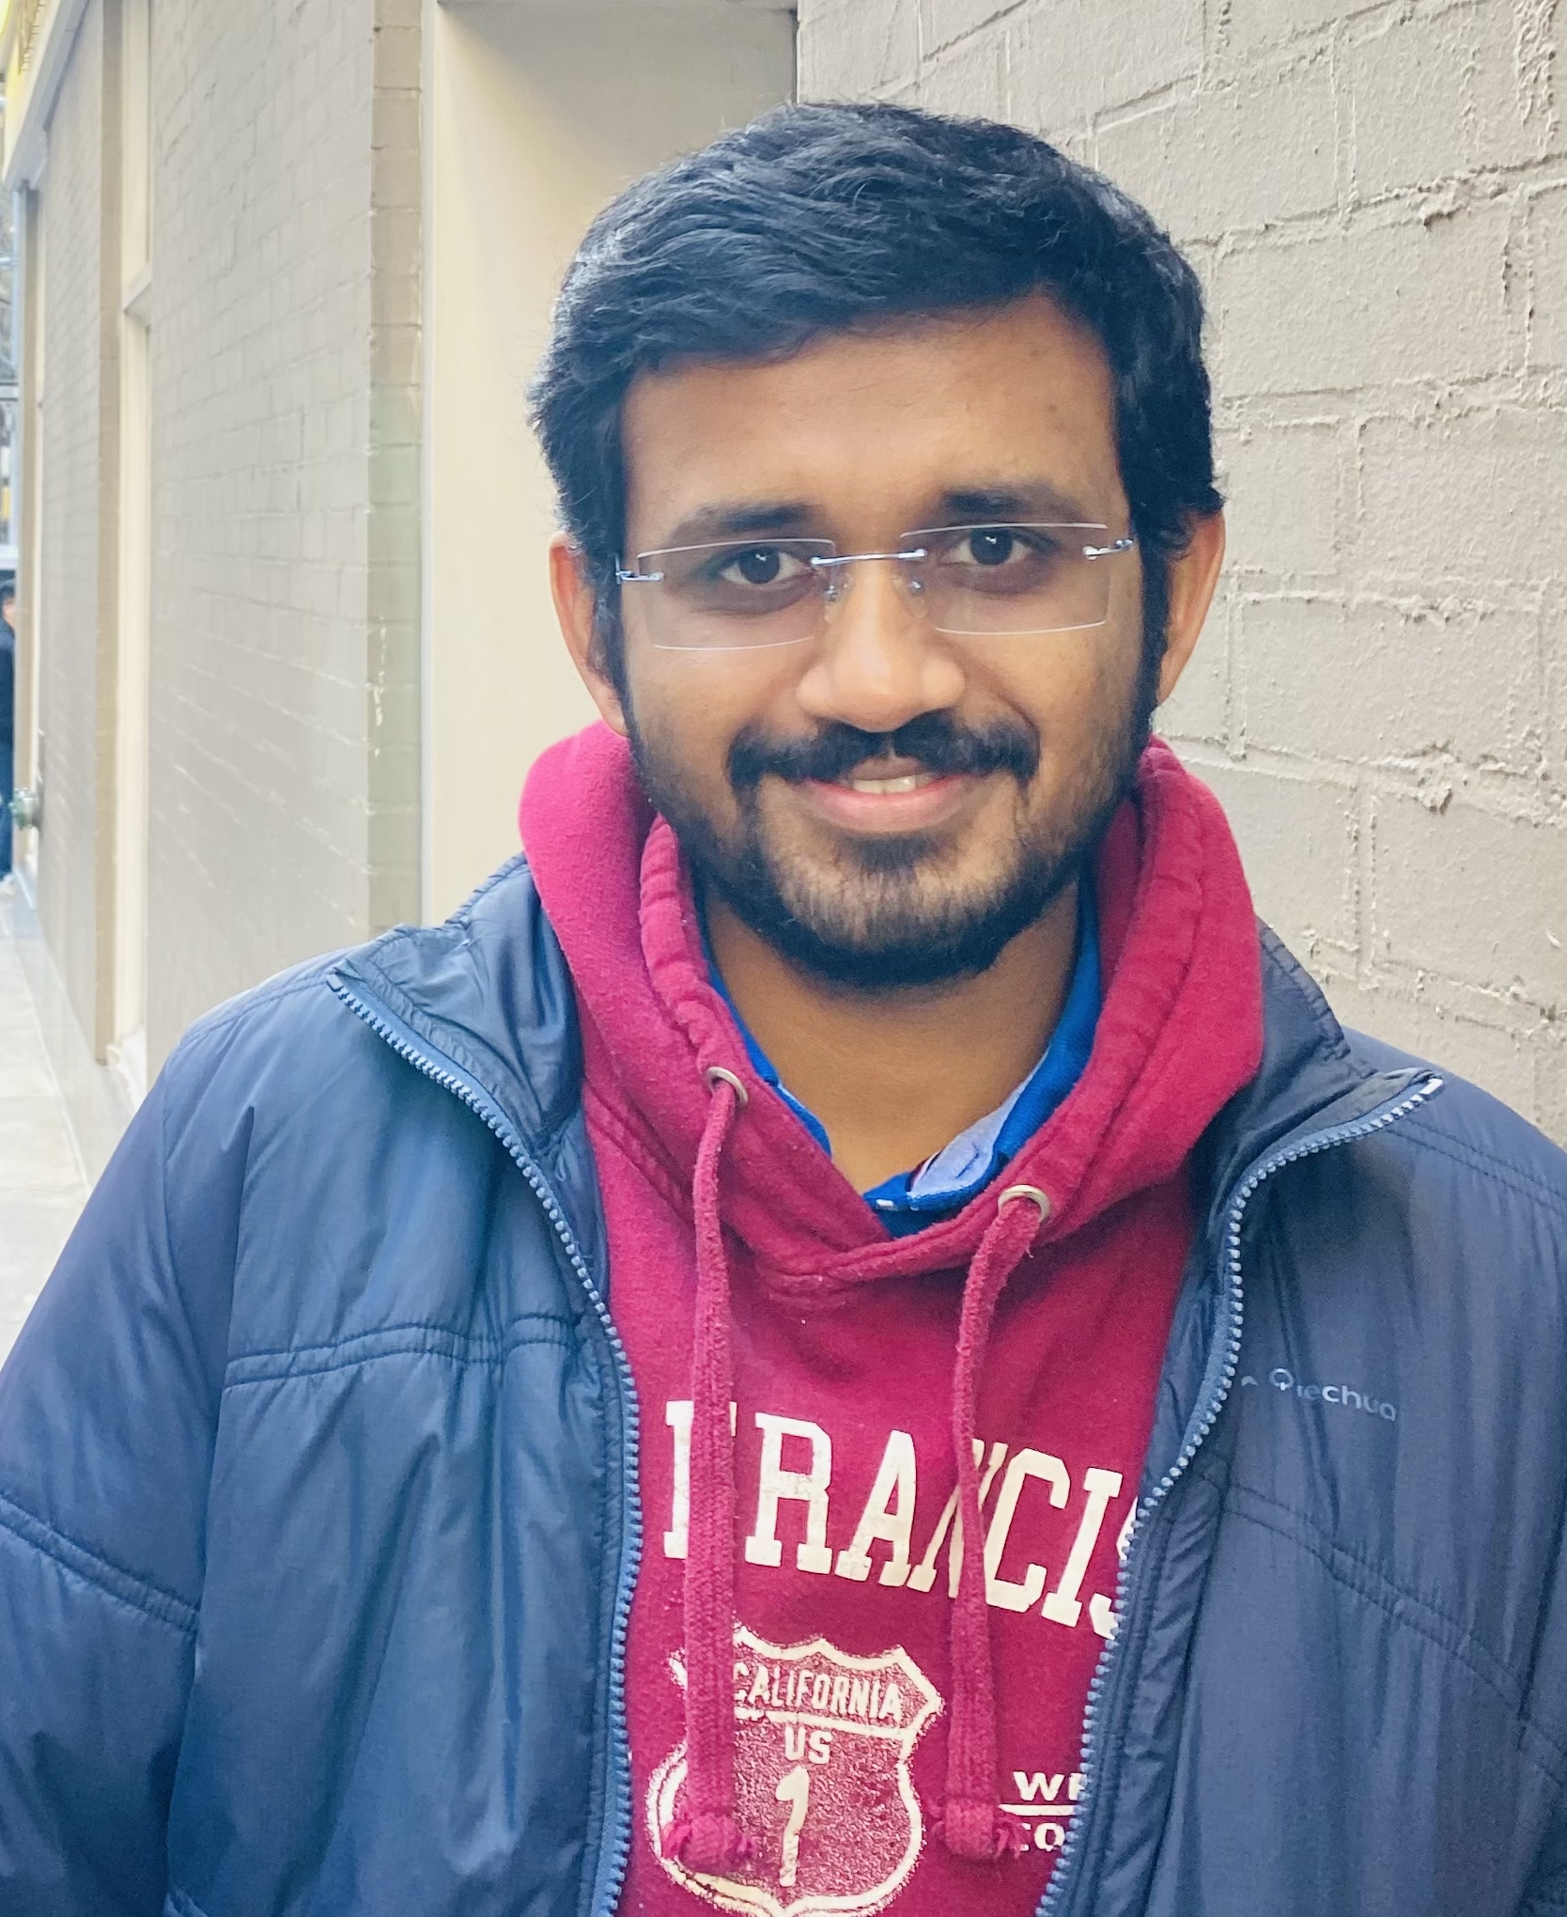
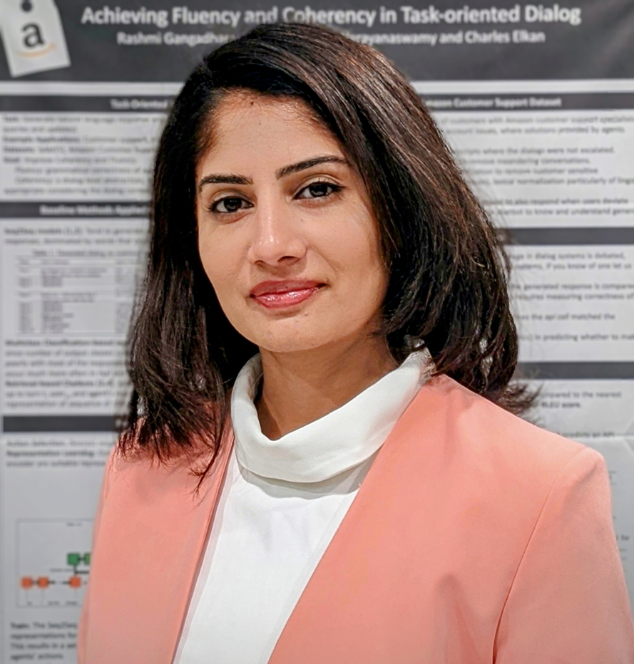
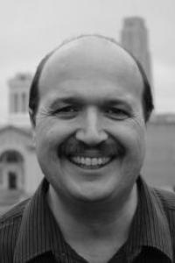
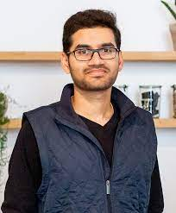
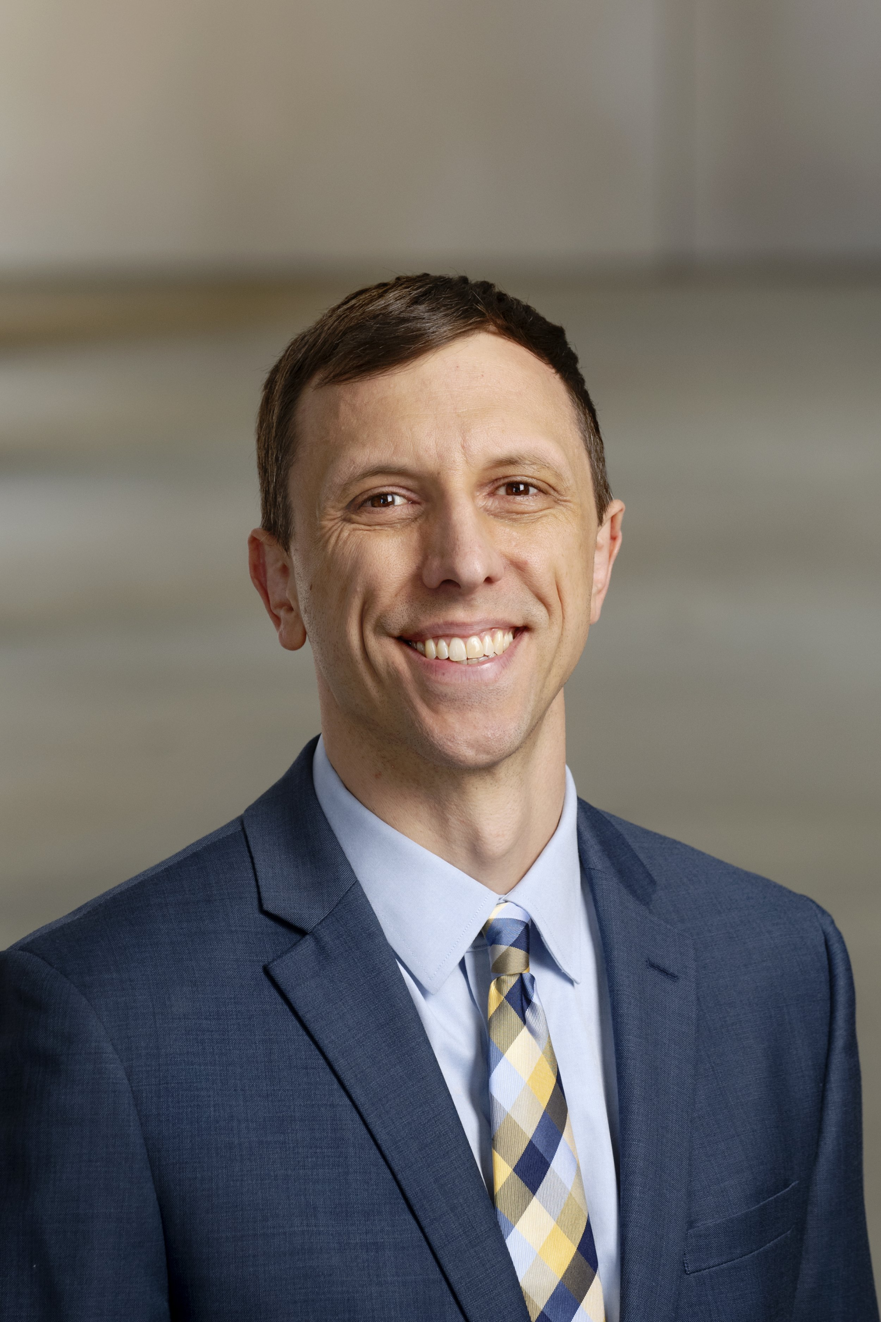

Sopan Khosla
AWS AI Labs
Chaitanya Shivade
AWS AI Labs
Vinayshekhar Bannihatti
AWS AI Labs
Rashmi Gangadharaiah
AWS AI Labs
Thomas Schaaf
3M
Sandeep Konam
Hitloop
Kevin Lybarger
George Mason University
University of Washington
Aleksandar Savkov
JABS MedTech

